Slide 1





Data Visualization with Matplotlib and Seaborn

Slide 2

Hello!
I am Eslam Ahmed
I am a software engineer.
You can find me at jeksogsa@gmail.com

Slide 3

Hello!
I am Eman Ehab
I am a ML research engineer.
You can find me at emanehab.ieee@gmail.com

Slide 4
Agenda
What is Data Visualization
Matplotlib and Seaborn
Distribution Plots
Categorical Plots
Matrix Plots
Regression Plots
Color palettes
Change Plot Size

Slide 5
Agenda
What is Data Visualization
Matplotlib and Seaborn
Distribution Plots
Categorical Plots
Matrix Plots
Regression Plots
Color palettes
Change Plot Size

Slide 6
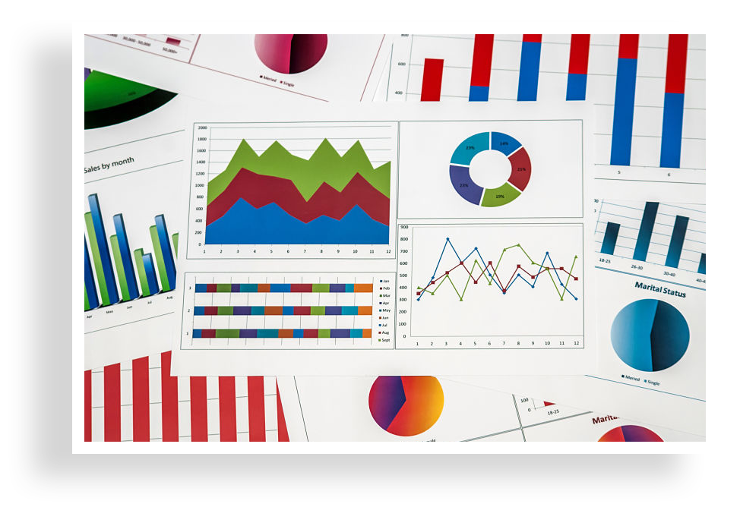



What is Data Visualization
Data visualization is the graphical representation of
information and data. By using visual elements like
charts, graphs, and maps, data visualization tools
provide an accessible way to see and understand
trends, outliers, and patterns in data.
Our eyes are drawn to colors and patterns. We can
quickly identify red from blue, square from circle. Our
culture is visual, including everything from art and
advertisements to TV and movies.
Data visualization is another form of visual art that
grabs our interest and keeps our eyes on the message.

Slide 7
Agenda
What is Data Visualization
Matplotlib and Seaborn
Distribution Plots
Categorical Plots
Matrix Plots
Regression Plots
Color palettes
Change Plot Size

Slide 8
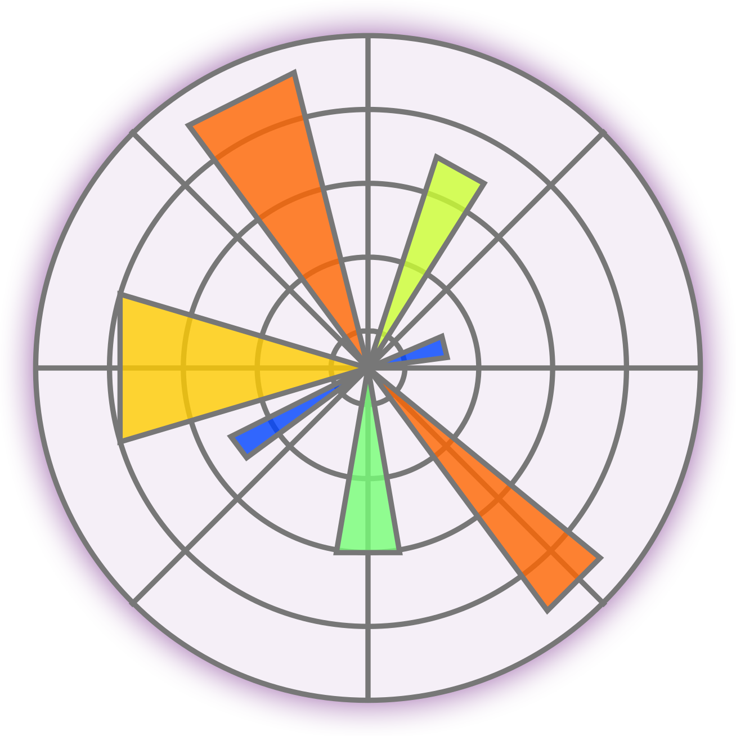

Matplotlib and Seaborn
Seaborn and Matplotlib are two of Python's most
powerful visualization libraries. Seaborn is built on top
of matplotlib so it’s more like a wrapper, Seaborn uses fewer
syntax and has stunning default themes and Matplotlib
is more easily customizable through accessing the classes.
We will focus on Seaborn as we know it’s so much easier
and give you a lot of out-of-the-box plots.
https://matplotlib.org/gallery/index.html
https://seaborn.pydata.org/index.html

Slide 9
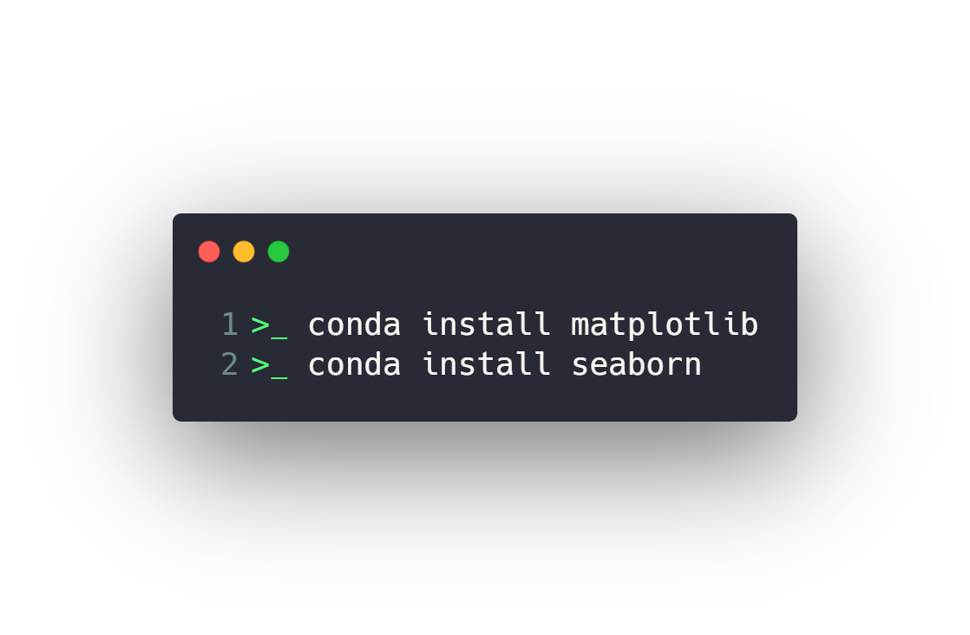
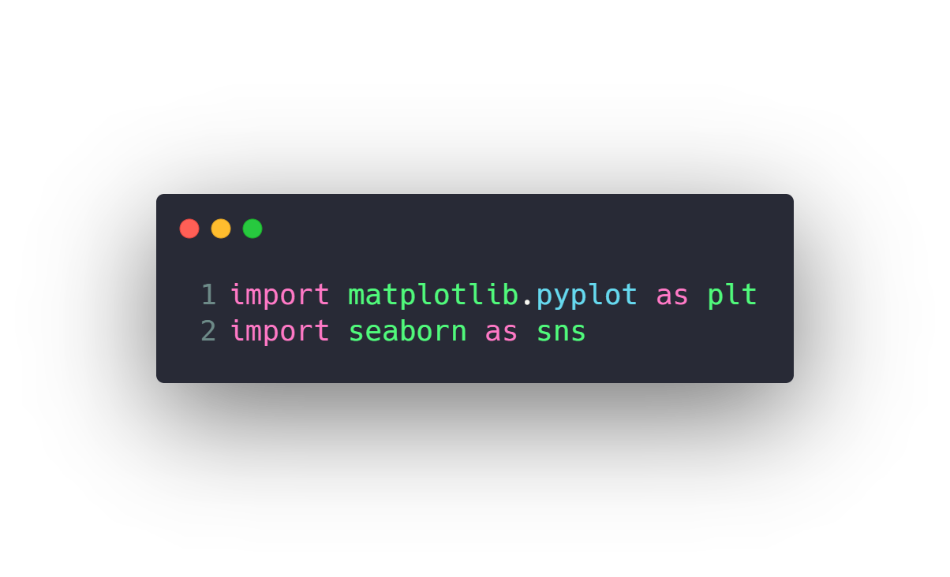
Matplotlib and Seaborn
Install
Use

Slide 10
Agenda
What is Data Visualization
Matplotlib and Seaborn
Distribution Plots
Categorical Plots
Matrix Plots
Regression Plots
Color palettes
Change Plot Size

Slide 11
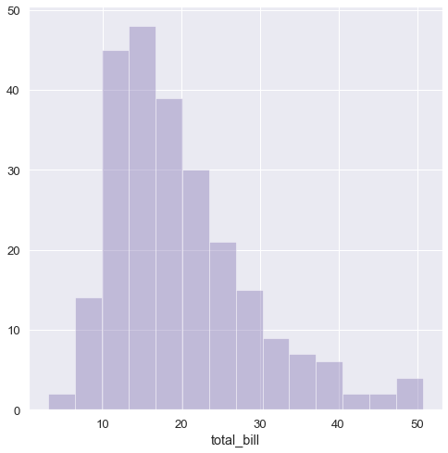
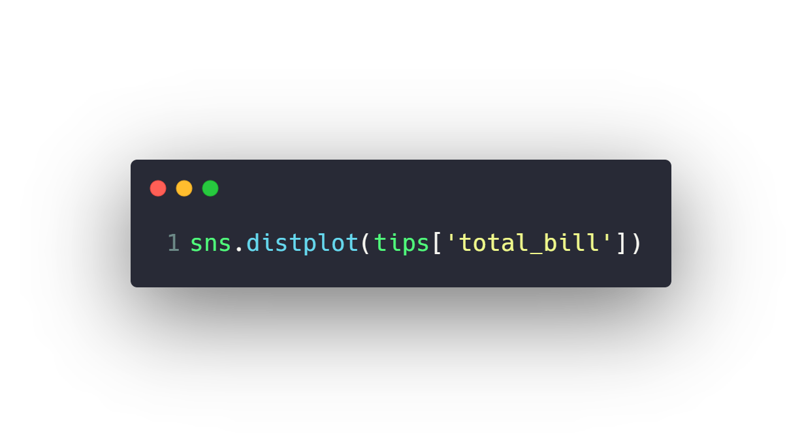
Distribution Plots
Univariate Plots
distplot
kdeplot
Bivariate Plots
jointplot
pairplot

Slide 12
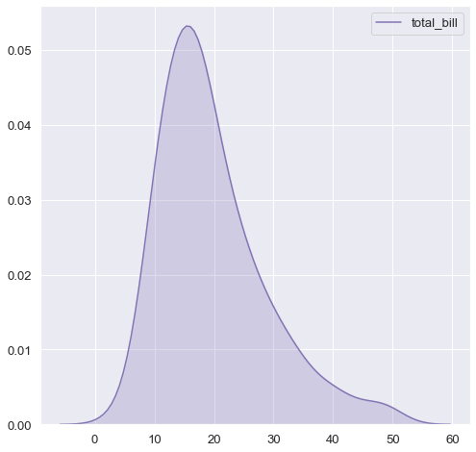
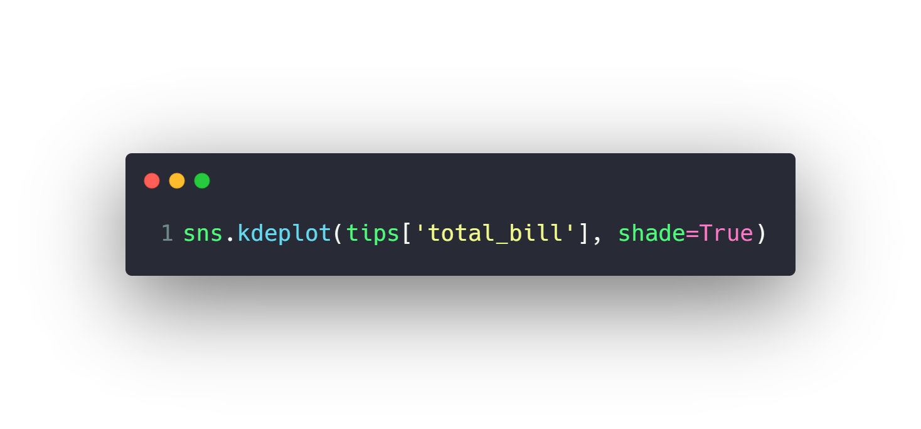
Distribution Plots
Univariate Plots
distplot
kdeplot
Bivariate Plots
jointplot
pairplot

Slide 13
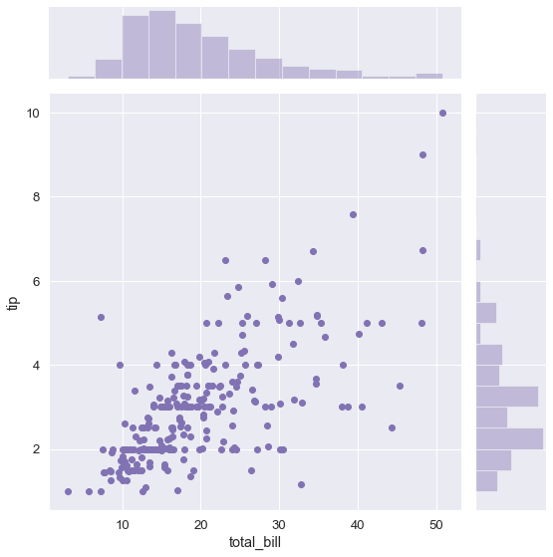
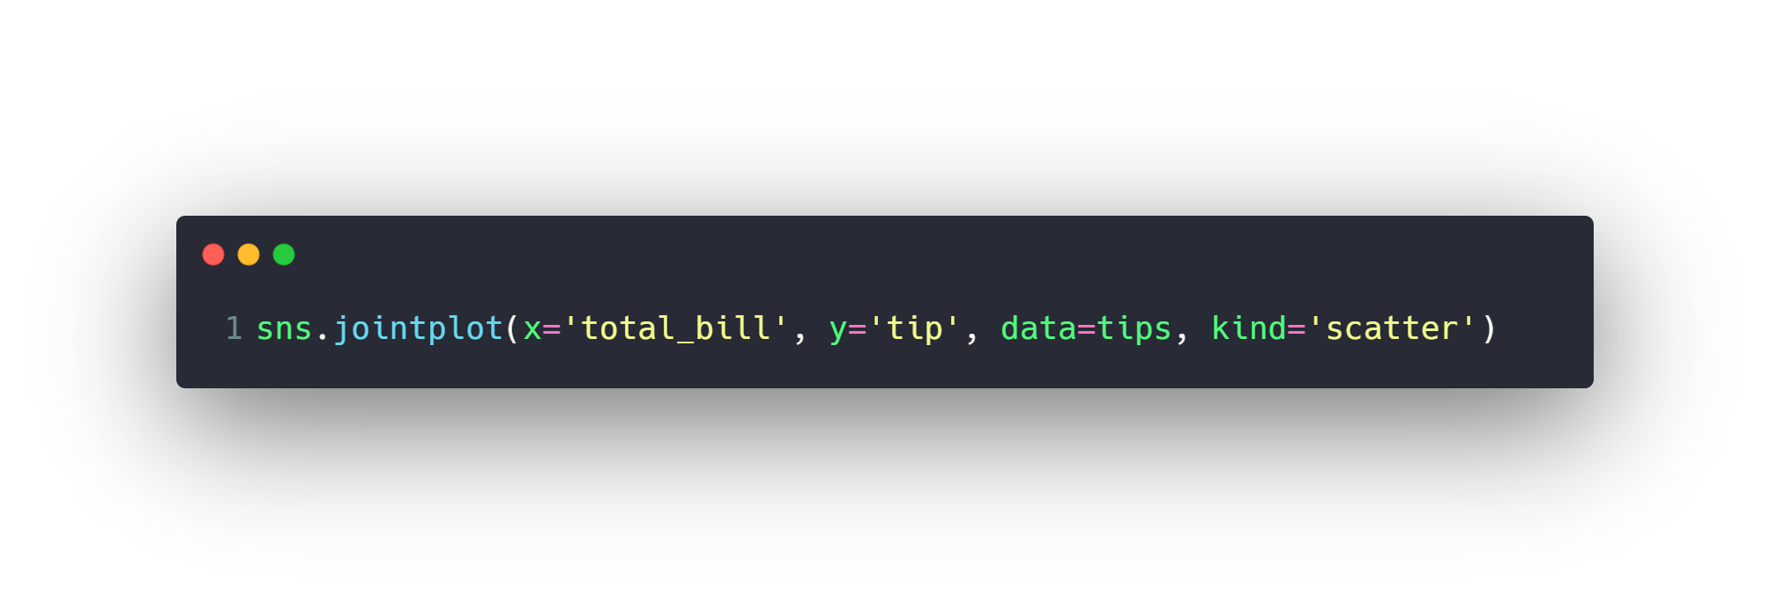
Distribution Plots
Univariate Plots
distplot
kdeplot
Bivariate Plots
jointplot
pairplot

Slide 14
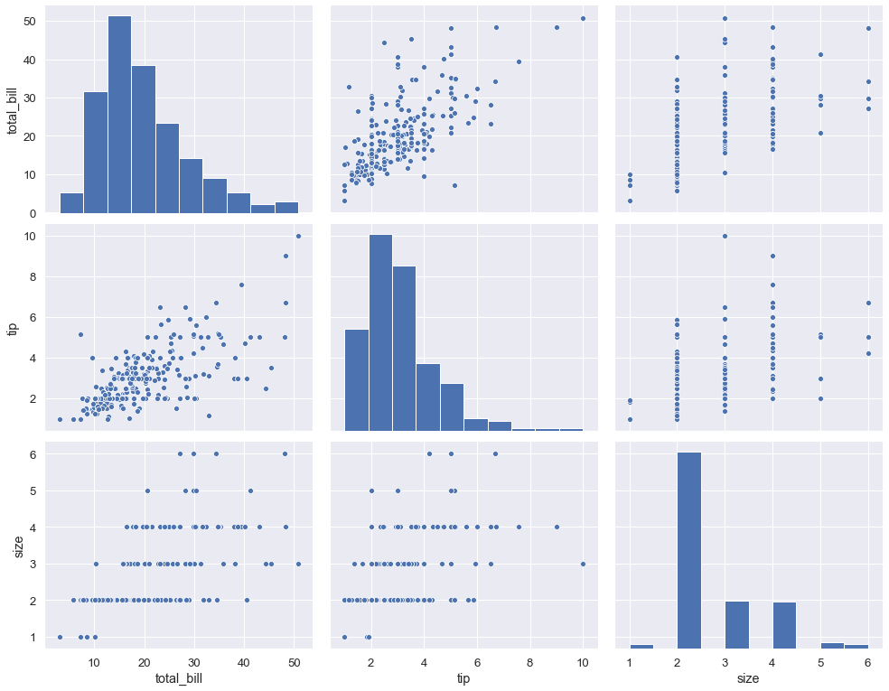
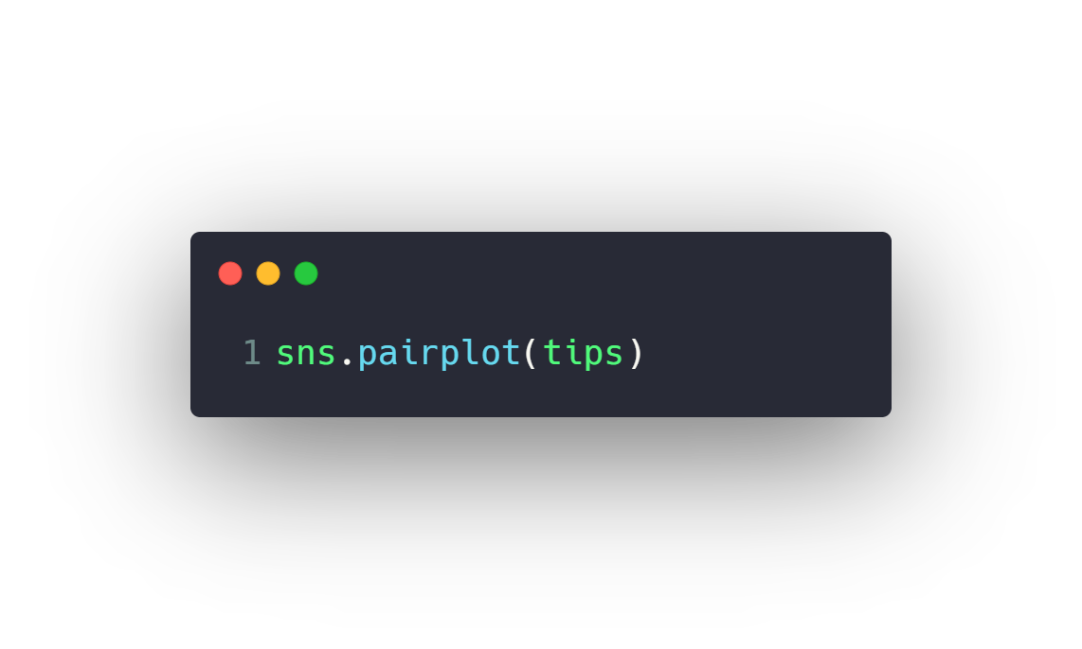
Distribution Plots
Univariate Plots
distplot
kdeplot
Bivariate Plots
jointplot
pairplot

Slide 15
Agenda
What is Data Visualization
Matplotlib and Seaborn
Distribution Plots
Categorical Plots
Matrix Plots
Regression Plots
Color palettes
Change Plot Size

Slide 16
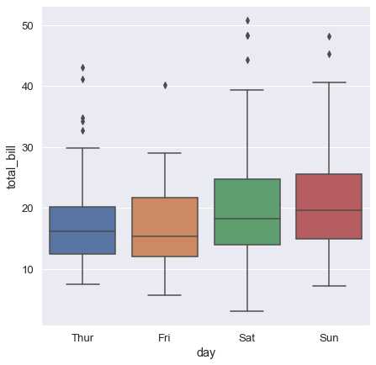
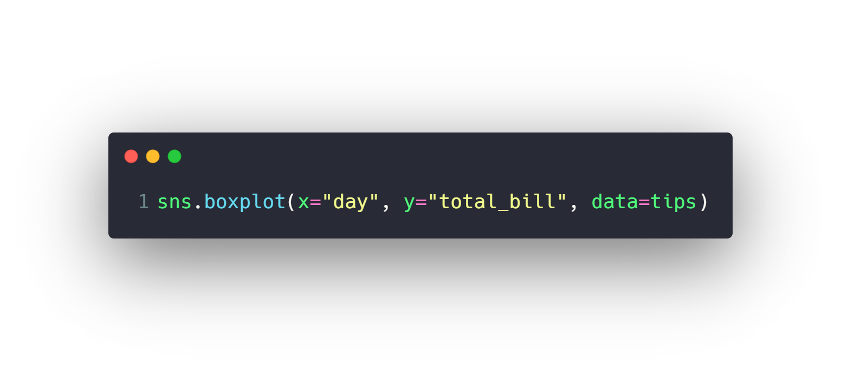
Categorical Plots
Categorical Distribution Plots
boxplot
violinplot
Categorical Scatter Plots
stripplot
swarmplot
Categorical Estimate Plots
barplot
countplot

Slide 17
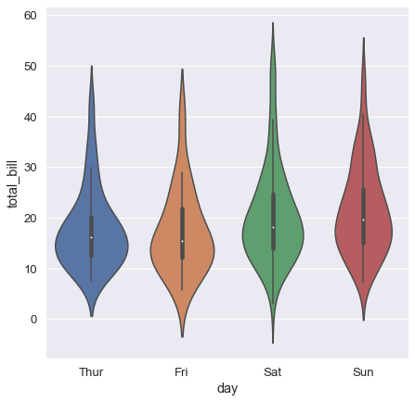
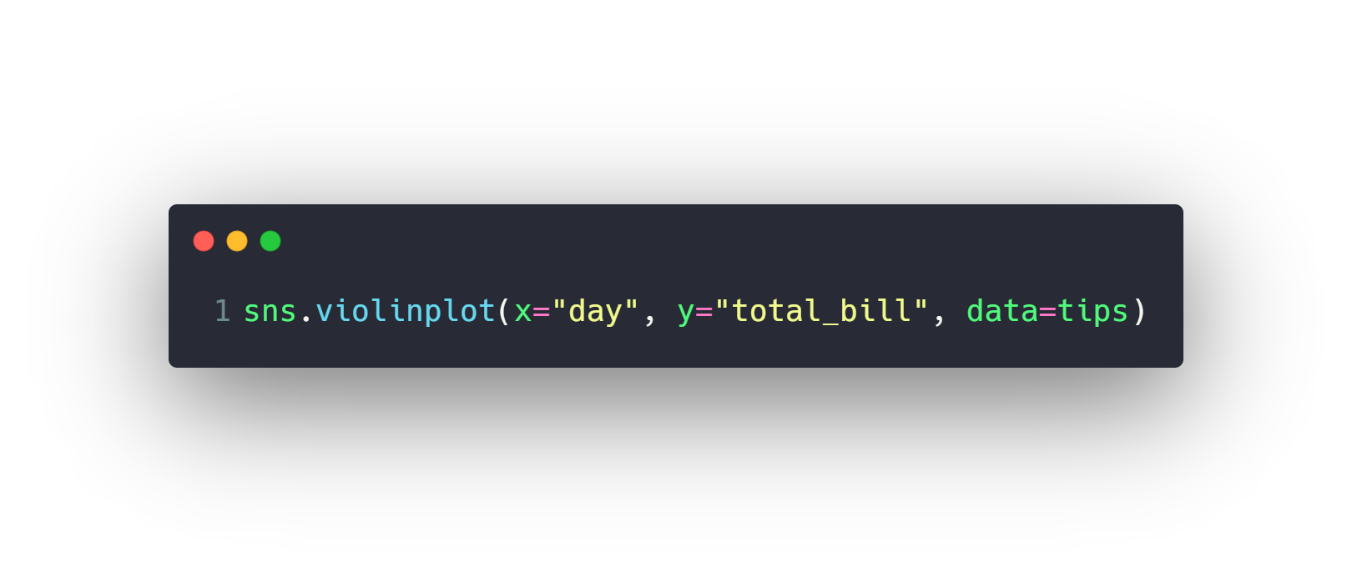
Categorical Plots
Categorical Distribution Plots
boxplot
violinplot
Categorical Scatter Plots
stripplot
swarmplot
Categorical Estimate Plots
barplot
countplot

Slide 18
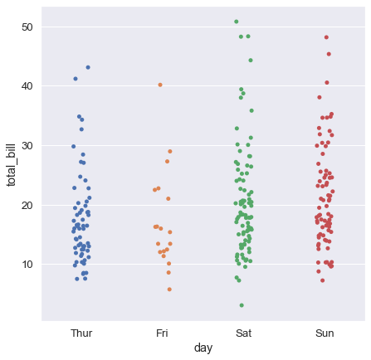
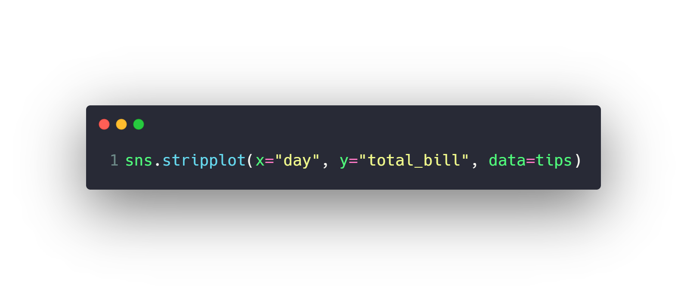
Categorical Plots
Categorical Distribution Plots
boxplot
violinplot
Categorical Scatter Plots
stripplot
swarmplot
Categorical Estimate Plots
barplot
countplot

Slide 19
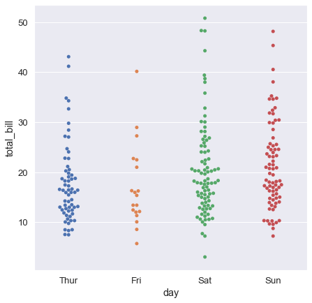
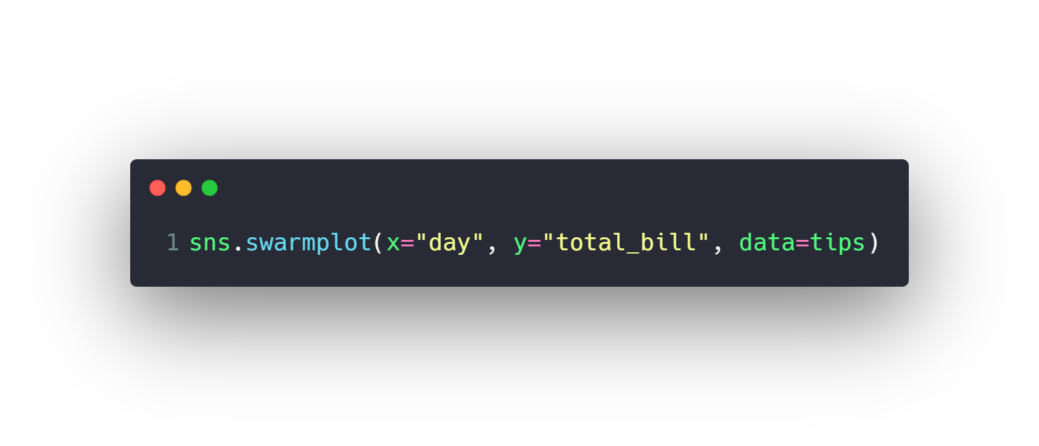
Categorical Plots
Categorical Distribution Plots
boxplot
violinplot
Categorical Scatter Plots
stripplot
swarmplot
Categorical Estimate Plots
barplot
countplot

Slide 20
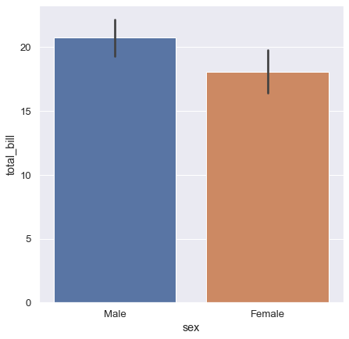
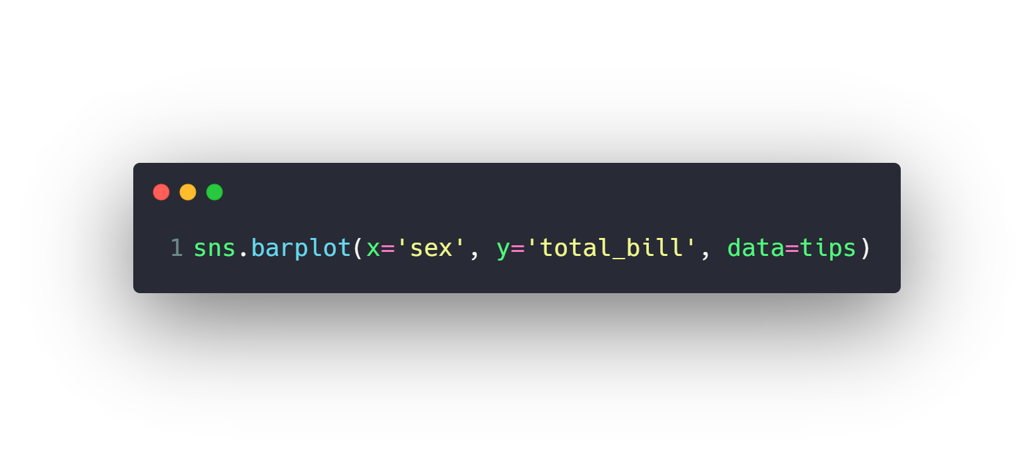
Categorical Plots
Categorical Distribution Plots
boxplot
violinplot
Categorical Scatter Plots
stripplot
swarmplot
Categorical Estimate Plots
barplot
countplot

Slide 21
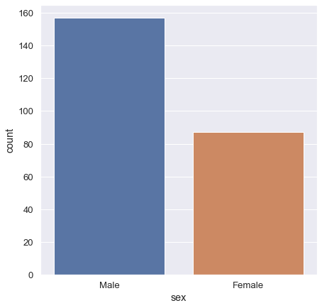
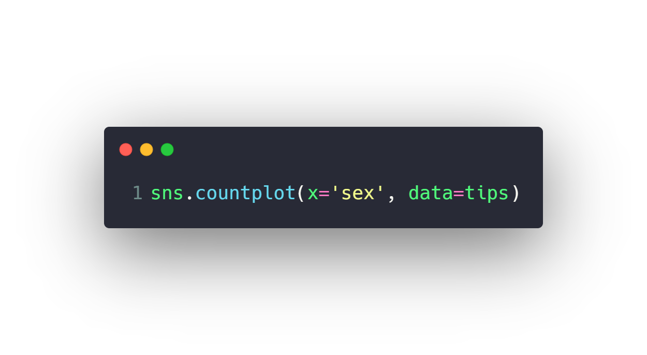
Categorical Plots
Categorical Distribution Plots
boxplot
violinplot
Categorical Scatter Plots
stripplot
swarmplot
Categorical Estimate Plots
barplot
countplot

Slide 22
Agenda
What is Data Visualization
Matplotlib and Seaborn
Distribution Plots
Categorical Plots
Matrix Plots
Regression Plots
Color palettes
Change Plot Size

Slide 23
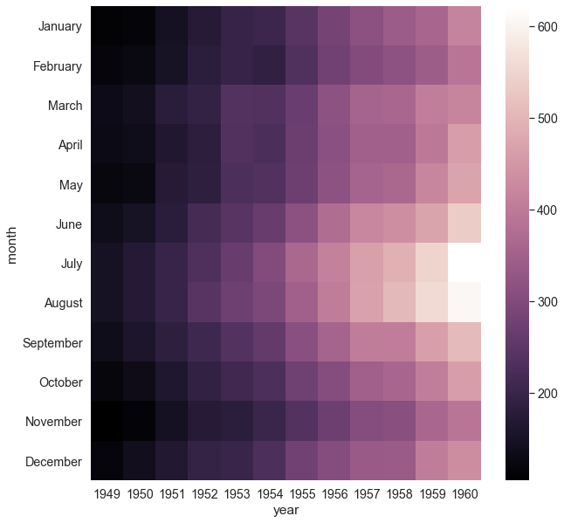
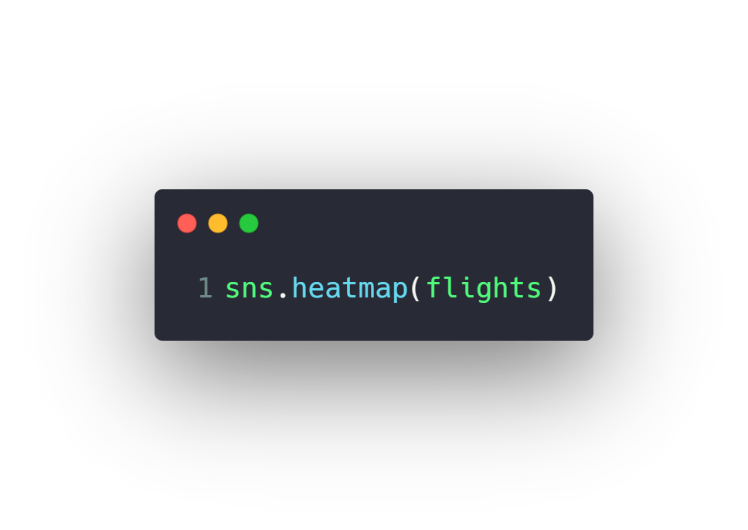
Matrix Plots
heatmap

Slide 24
Agenda
What is Data Visualization
Matplotlib and Seaborn
Distribution Plots
Categorical Plots
Matrix Plots
Regression Plots
Color palettes
Change Plot Size

Slide 25
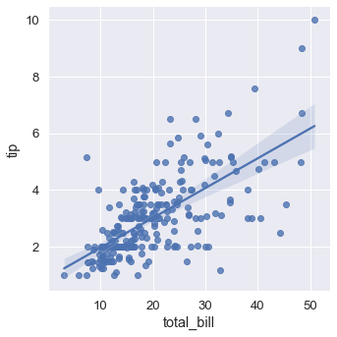
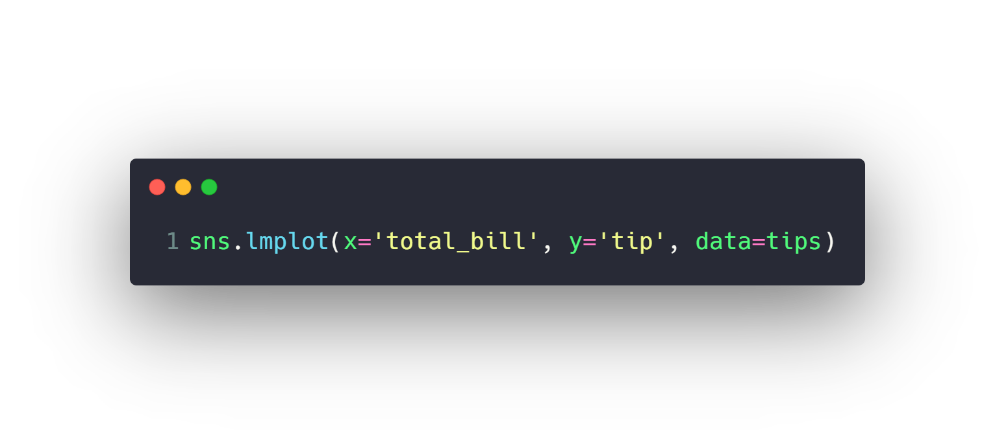
Regression Plots
lmplot

Slide 26
Agenda
What is Data Visualization
Matplotlib and Seaborn
Distribution Plots
Categorical Plots
Matrix Plots
Regression Plots
Color palettes
Change Plot Size

Slide 27
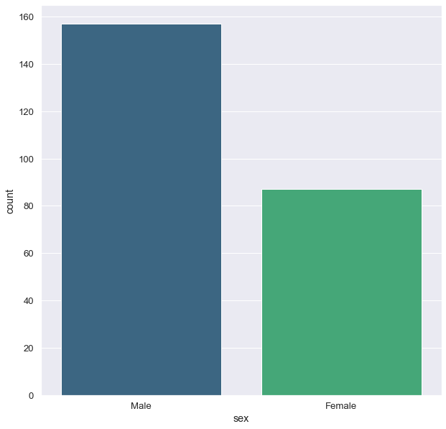
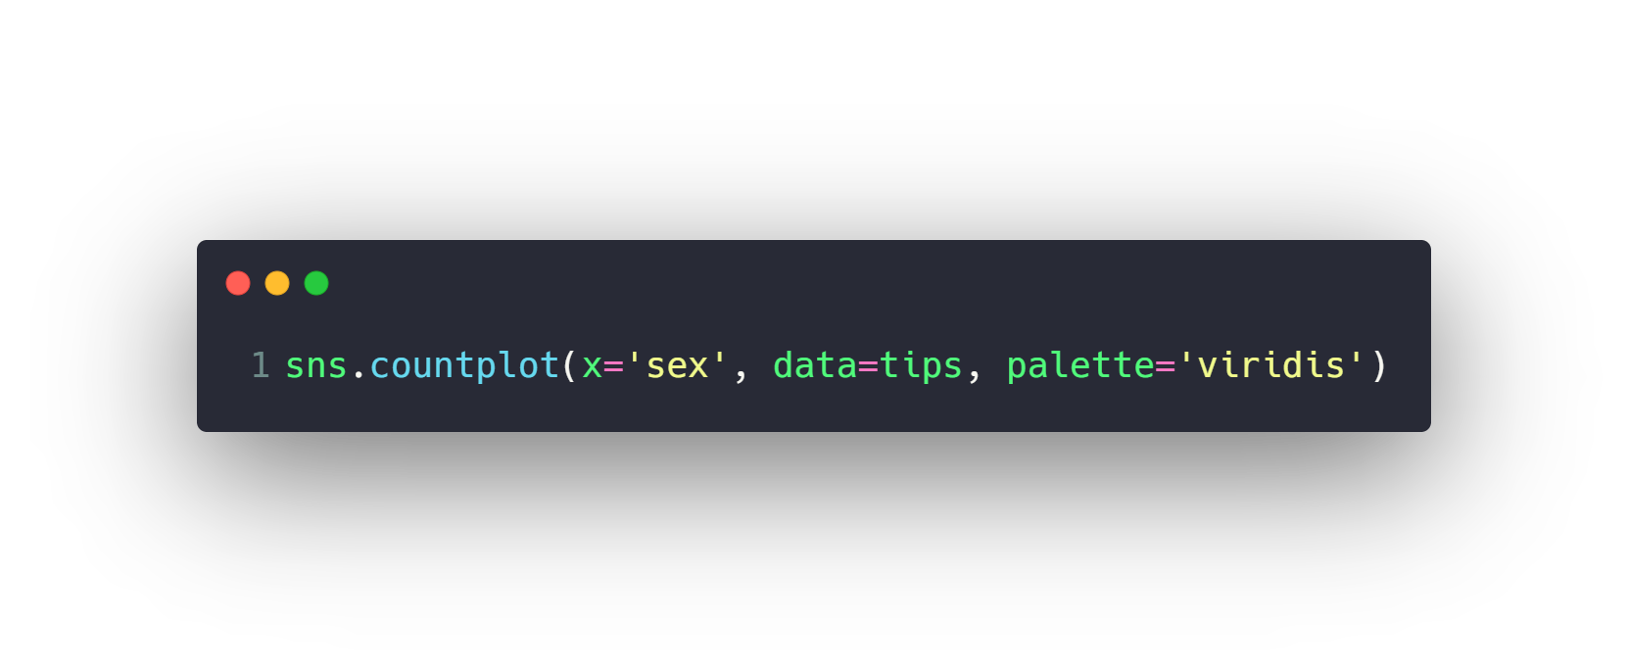
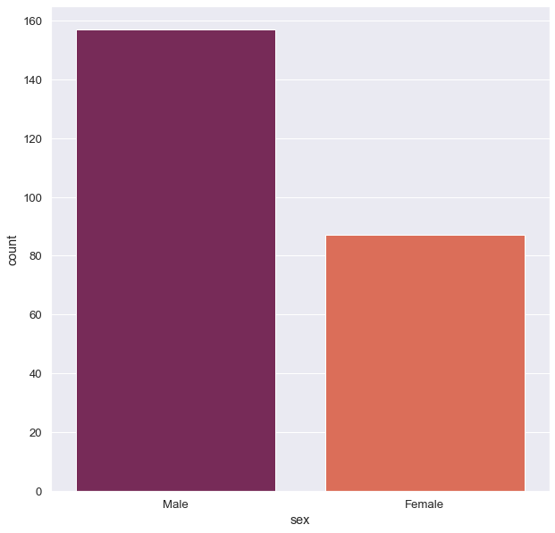
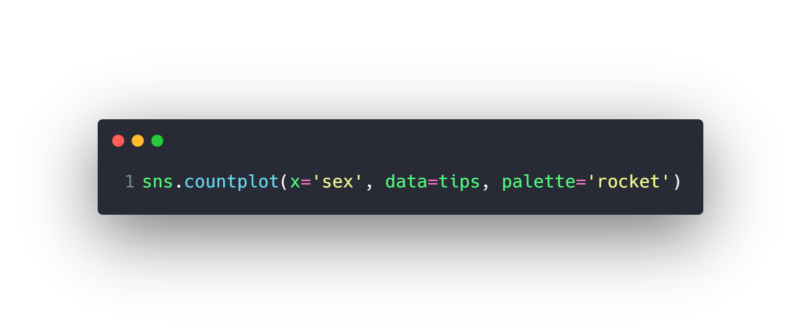
Color palettes
Set1
Set2
Set3
rocket
cubehelix
viridis
...
You can check all possible values for different color palettes from here
https://seaborn.pydata.org/tutorial/color_palettes.html

Slide 28
Agenda
What is Data Visualization
Matplotlib and Seaborn
Distribution Plots
Categorical Plots
Matrix Plots
Regression Plots
Color palettes
Change Plot Size

Slide 29
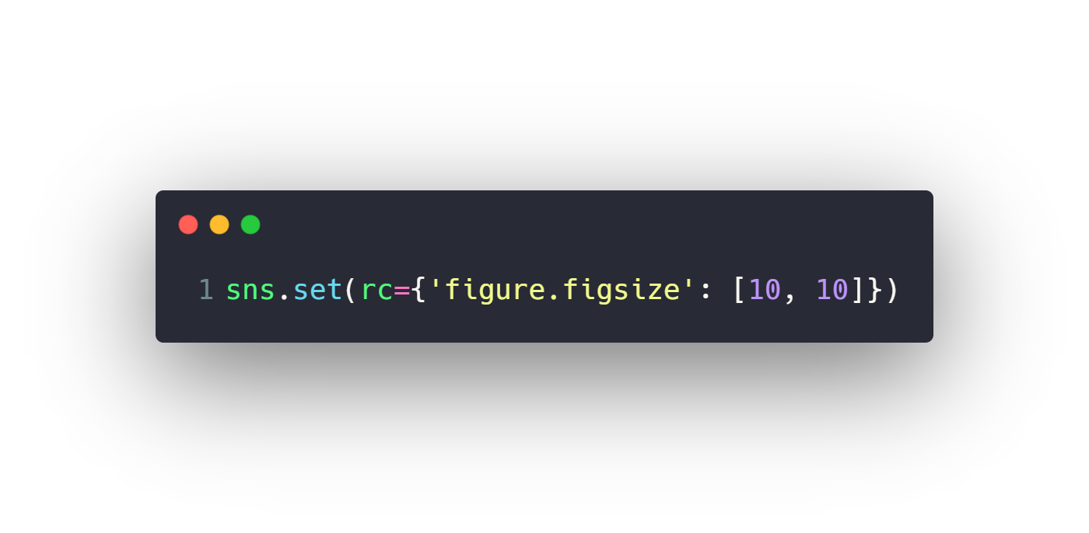
Change Plot Size
Change size with sns.set()
Change size with aspect and height
Change Font Scale

Slide 30
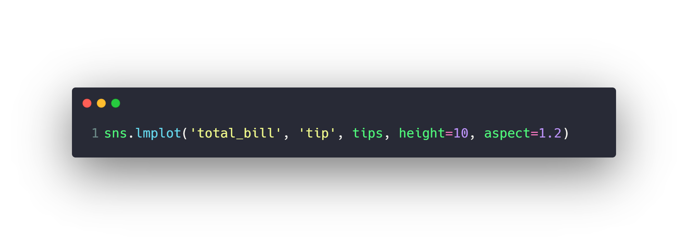
Change Plot Size
Change size with sns.set()
Change size with aspect and height
Change Font Scale

Slide 31
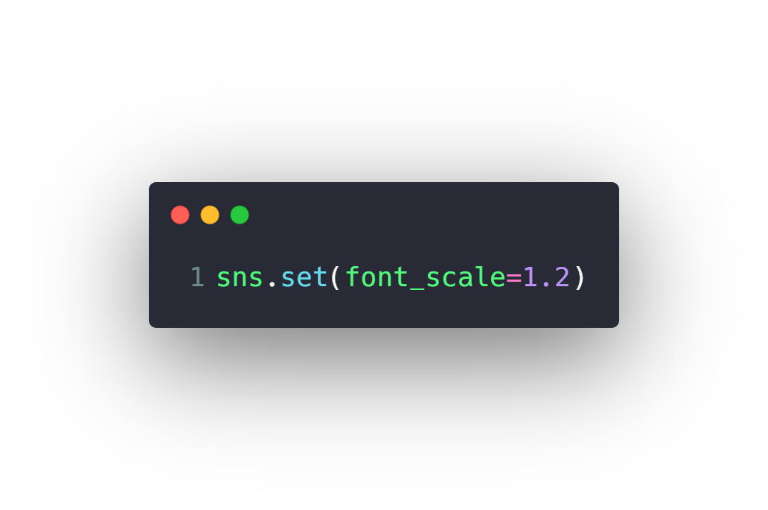
Change Plot Size
Change size with sns.set()
Change size with aspect and height
Change Font Scale

Slide 32
Questions ?!

Slide 33

Thanks! >_ Live long and prosper

